Slide 1
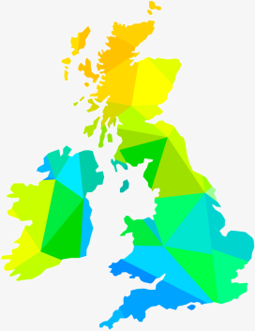
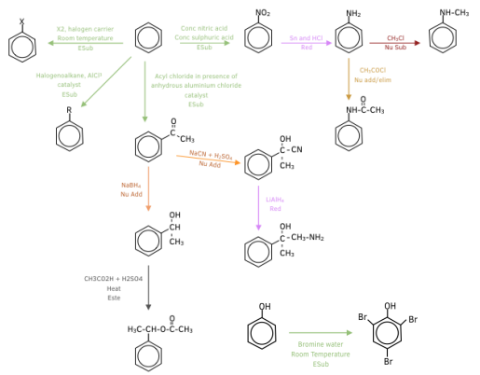
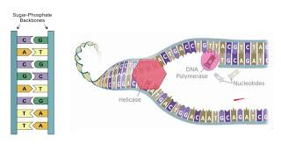
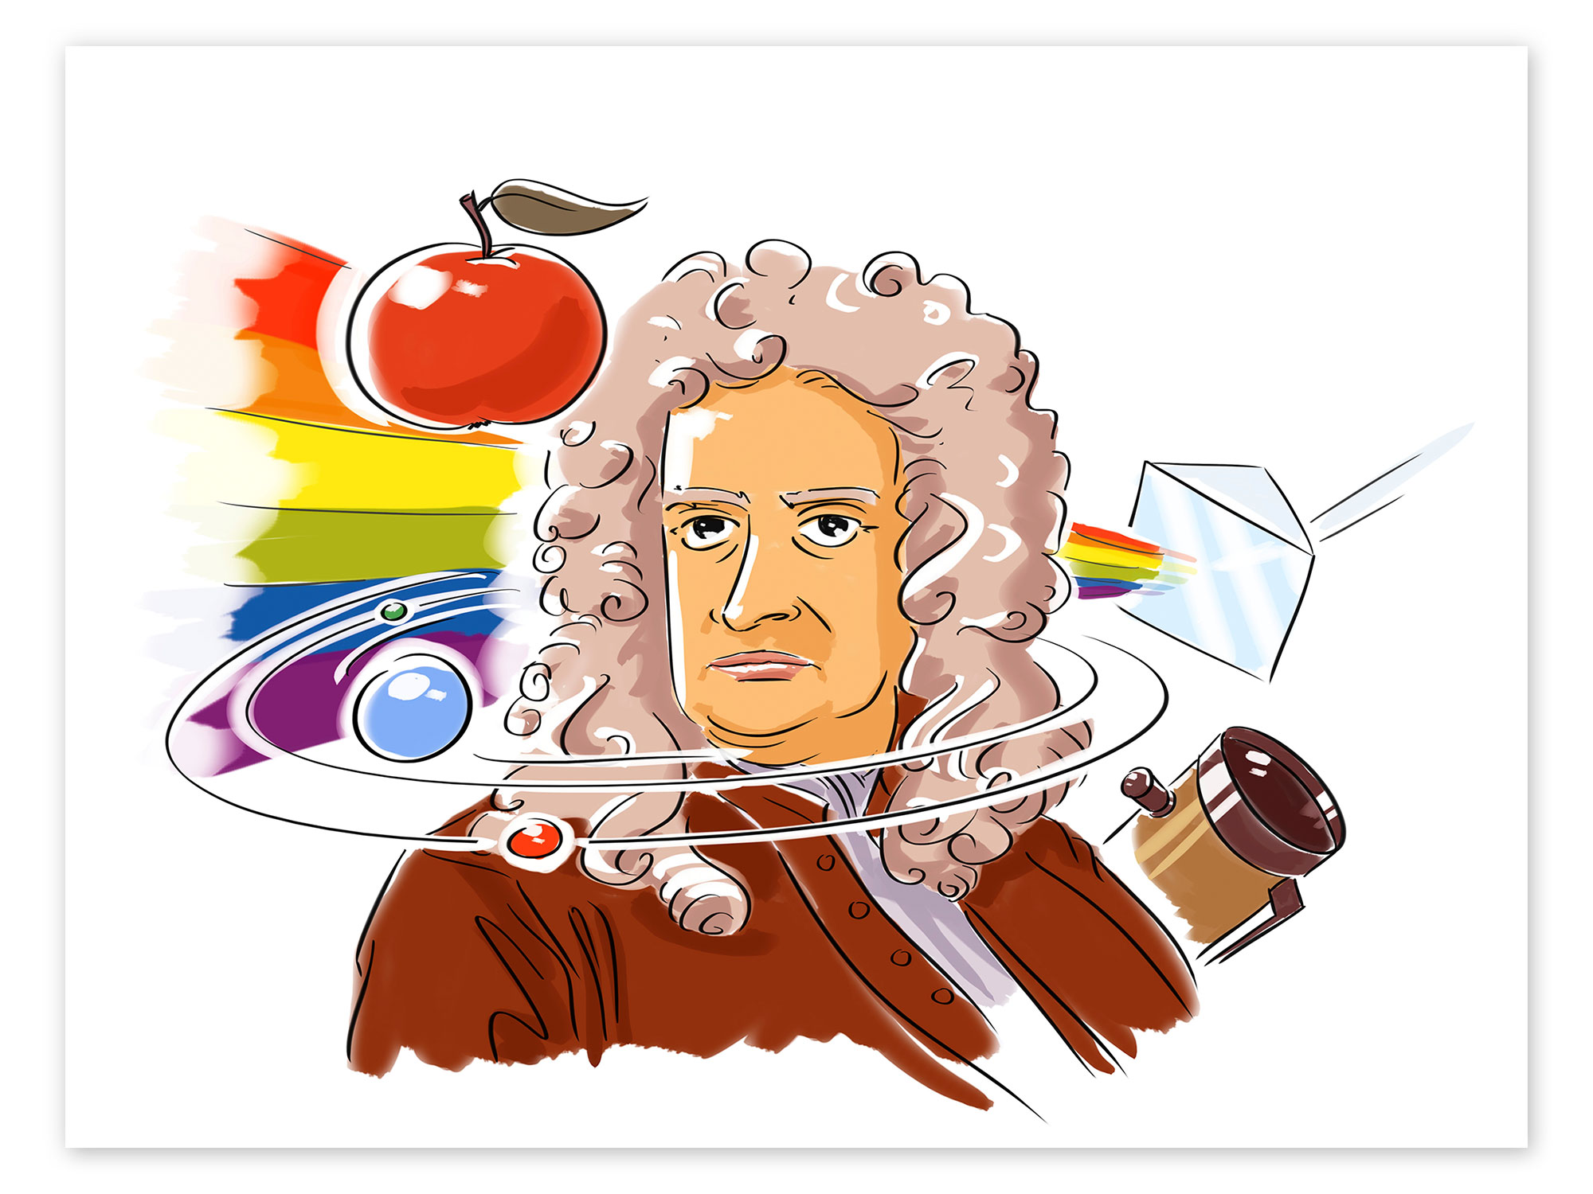
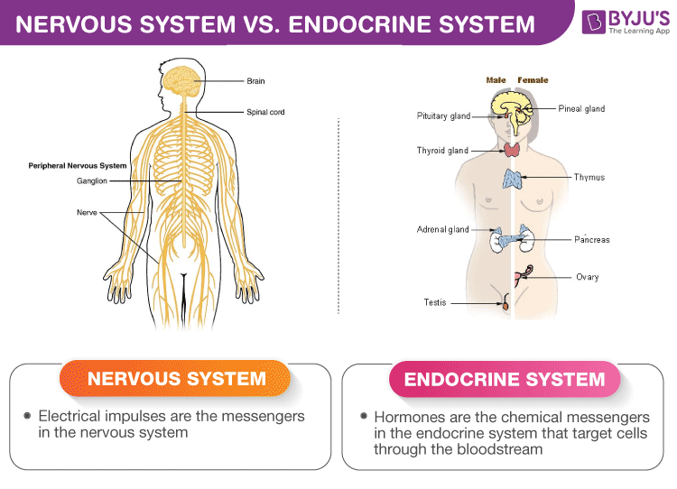
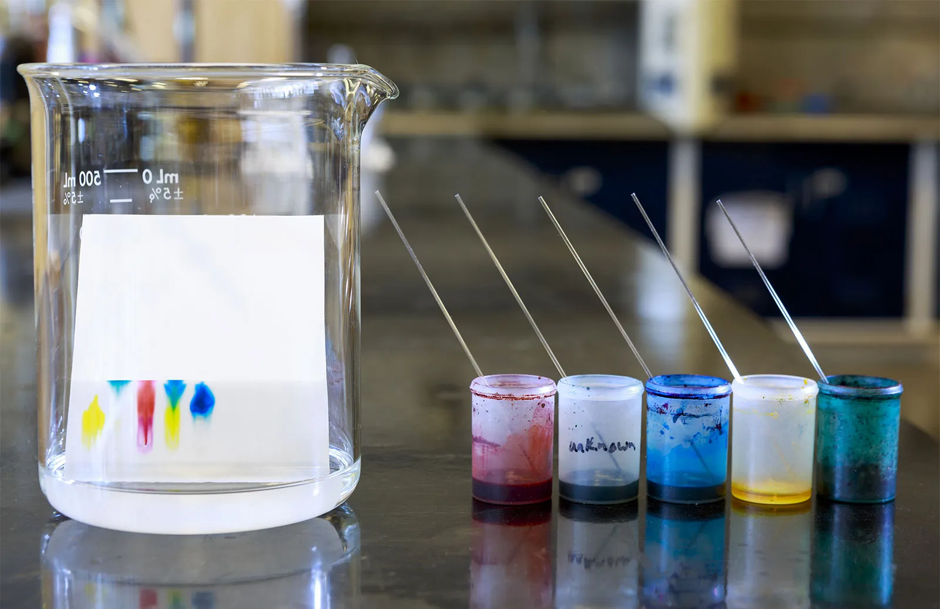
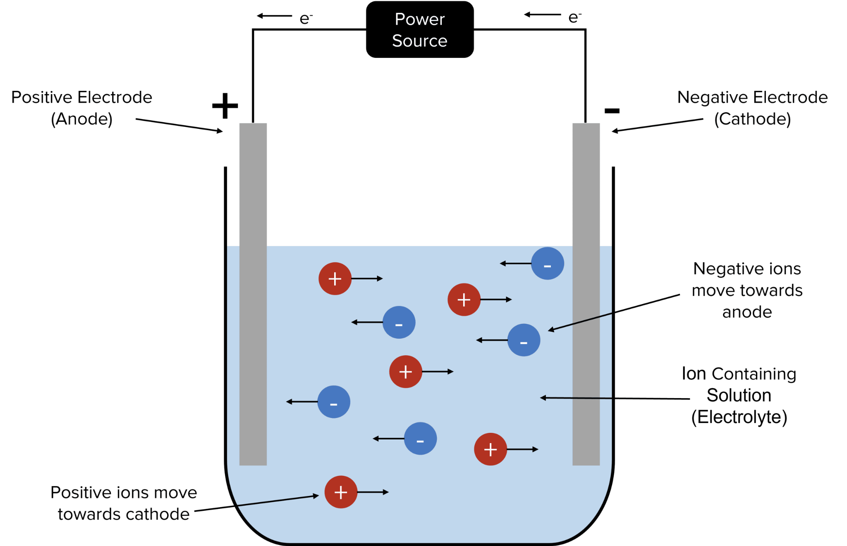
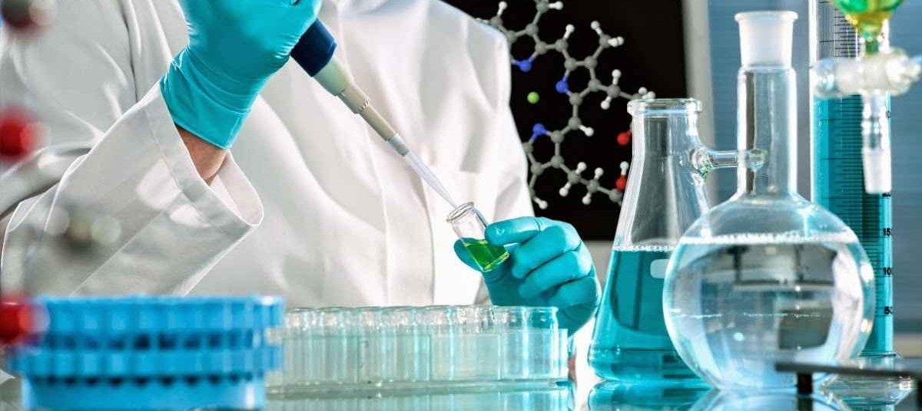
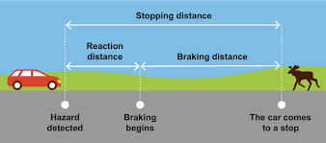
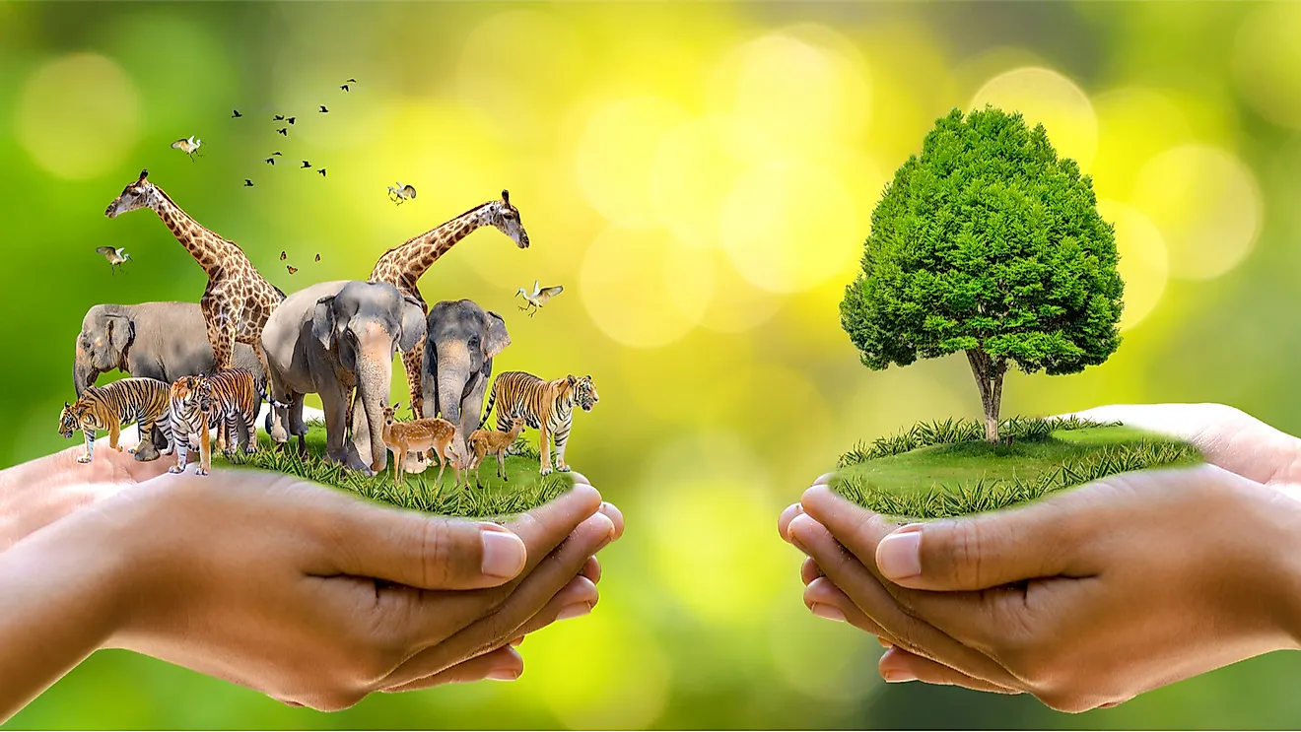
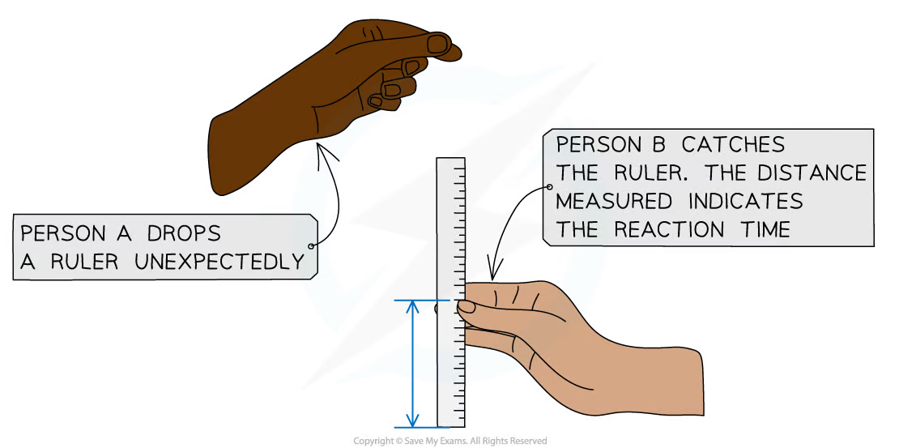
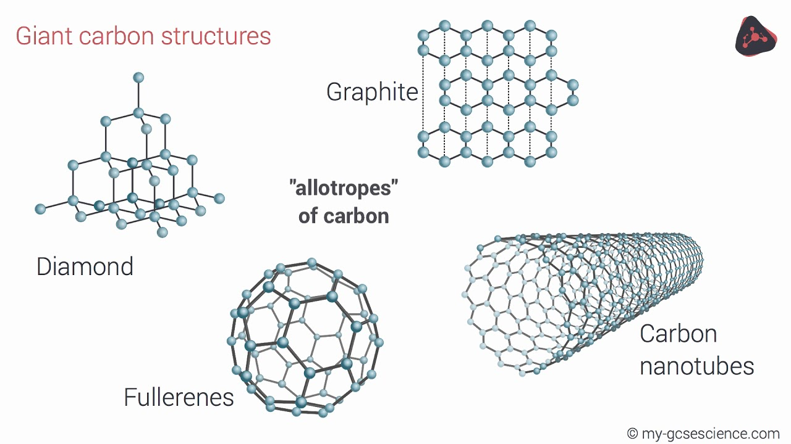
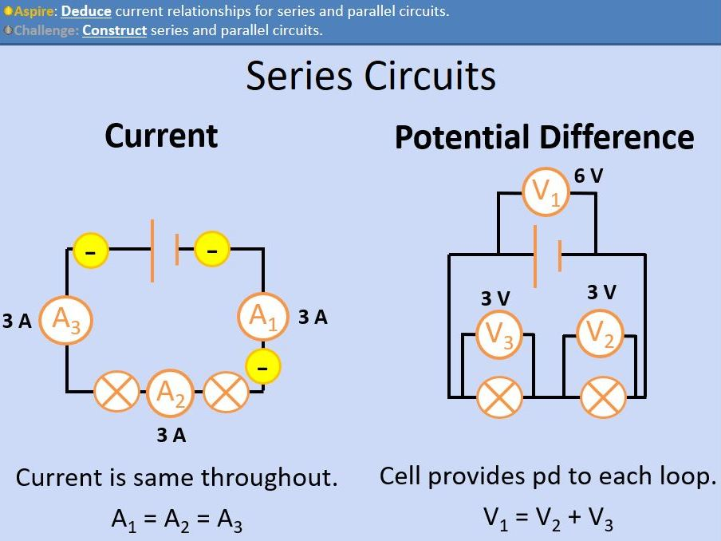
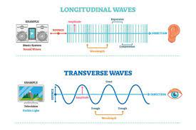
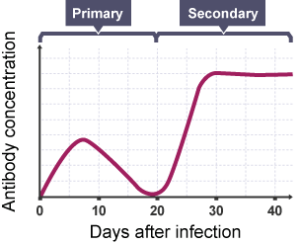
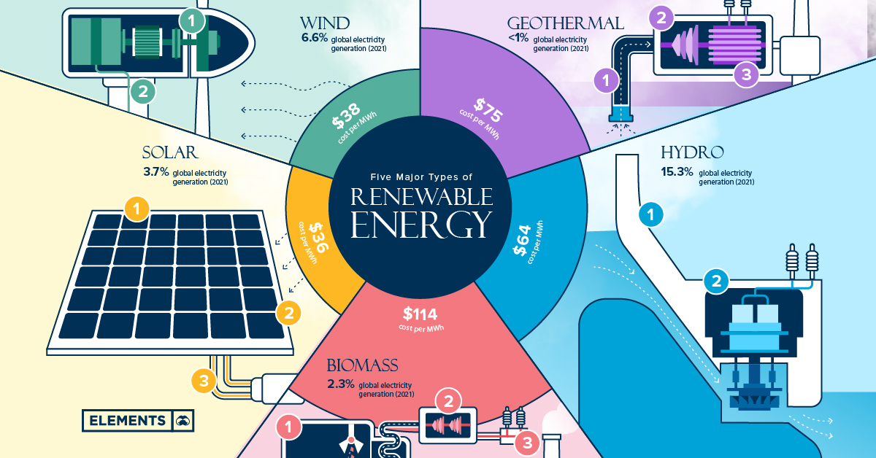
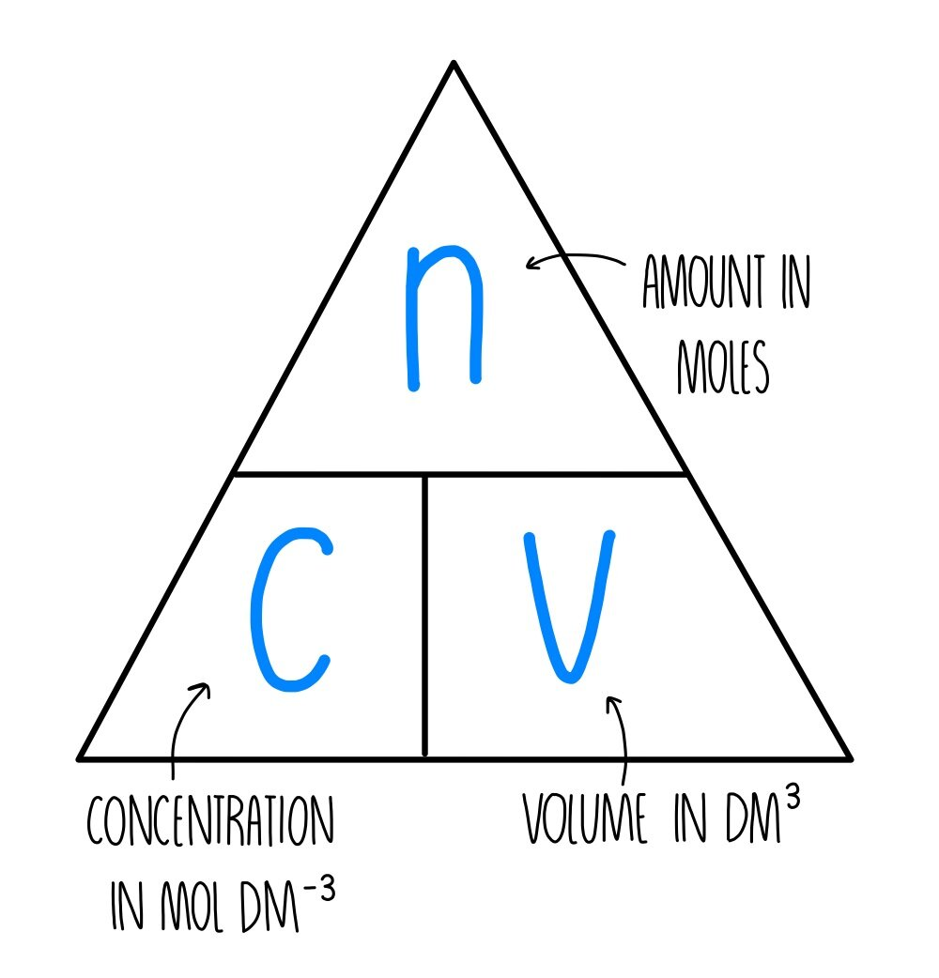
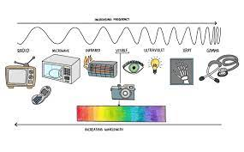
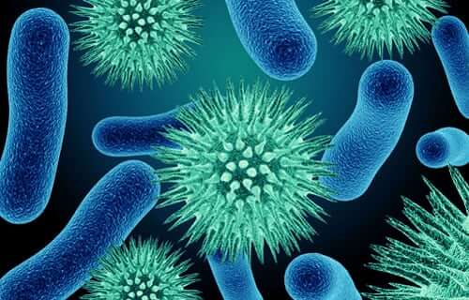
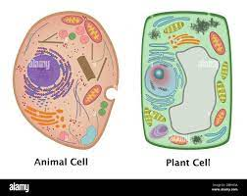
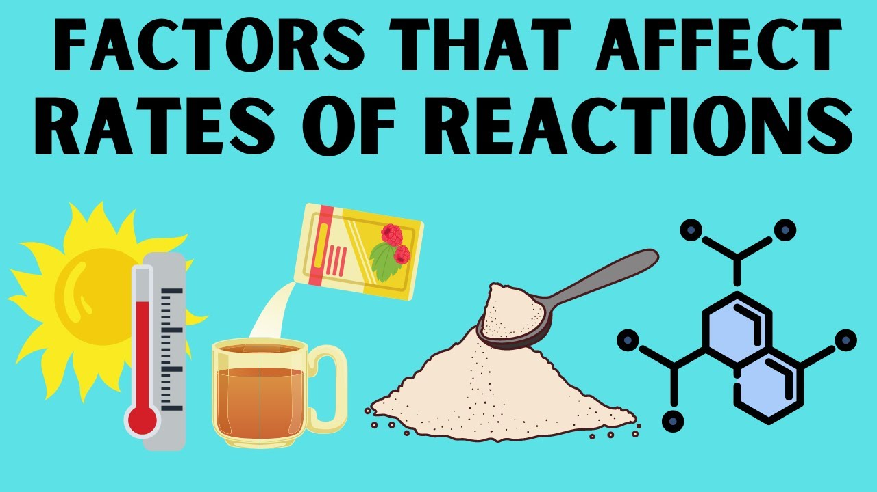
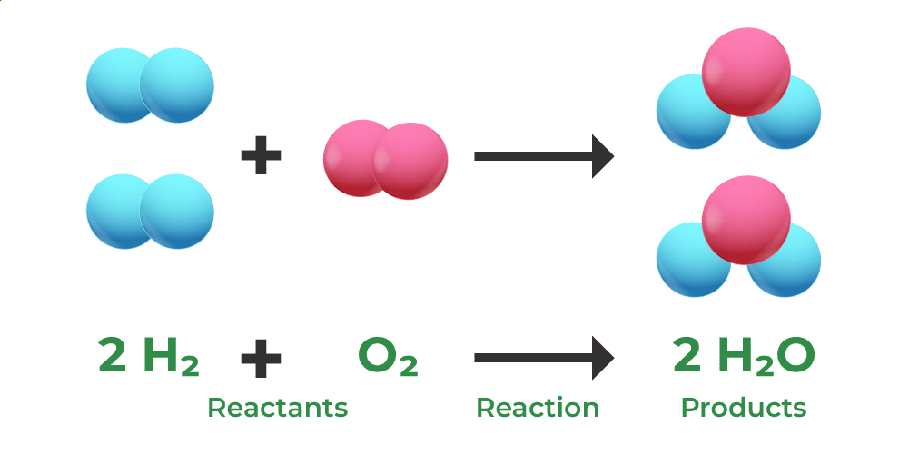
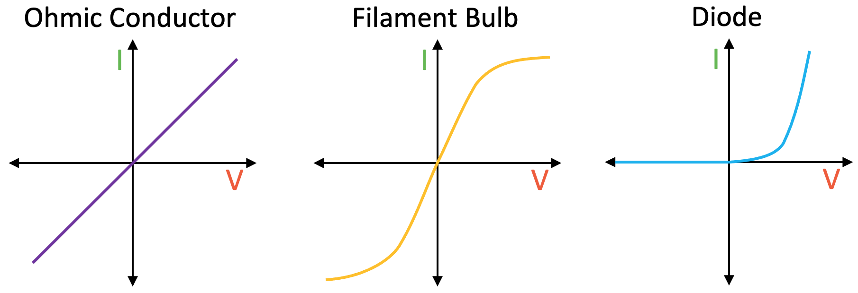
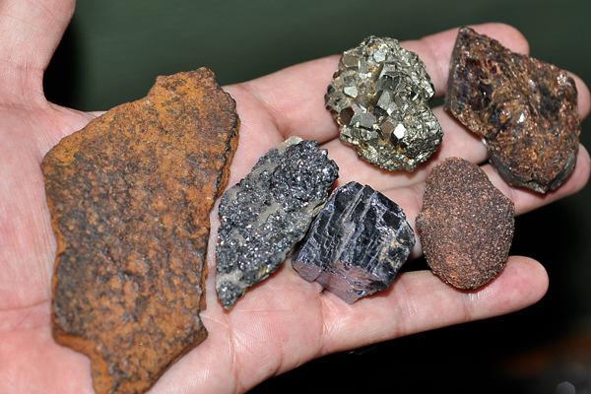
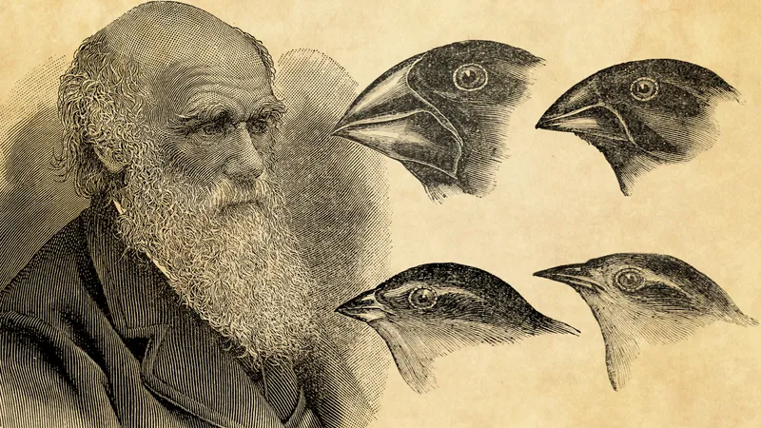
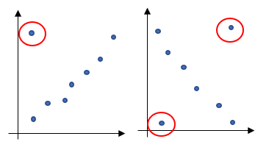
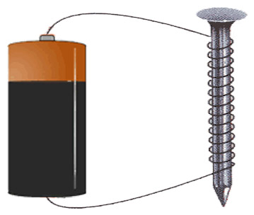
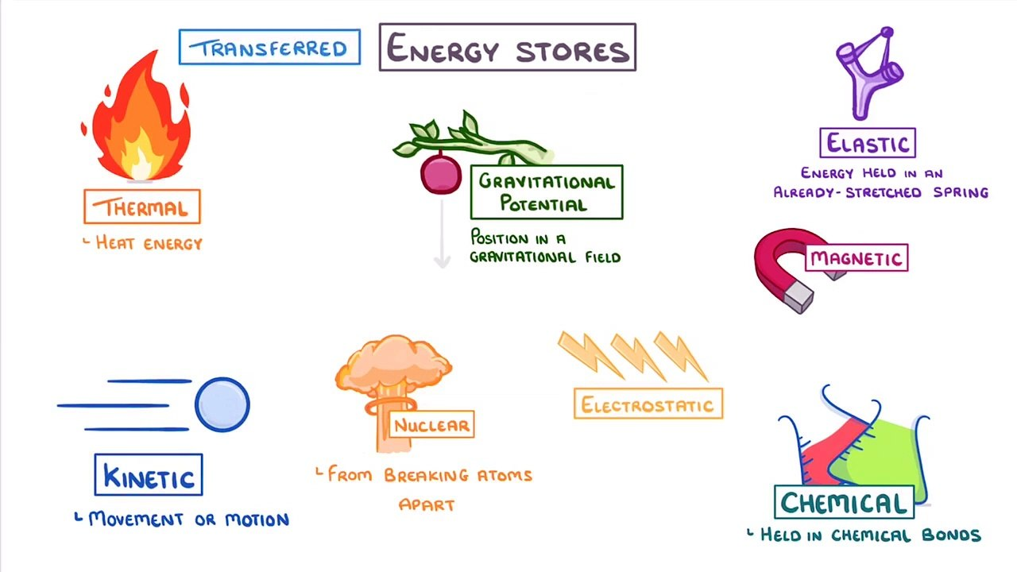
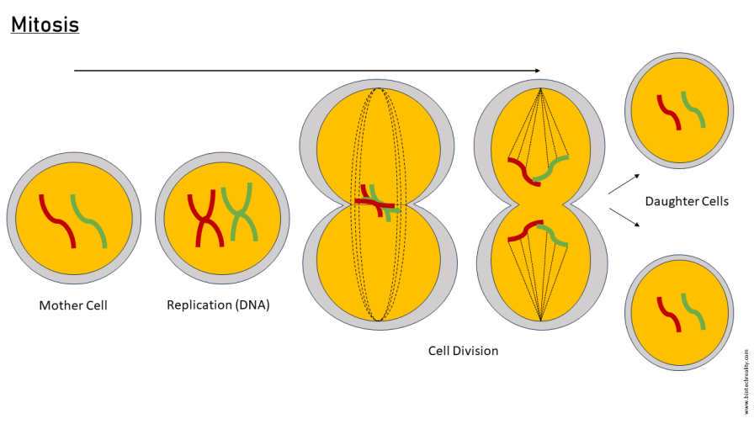
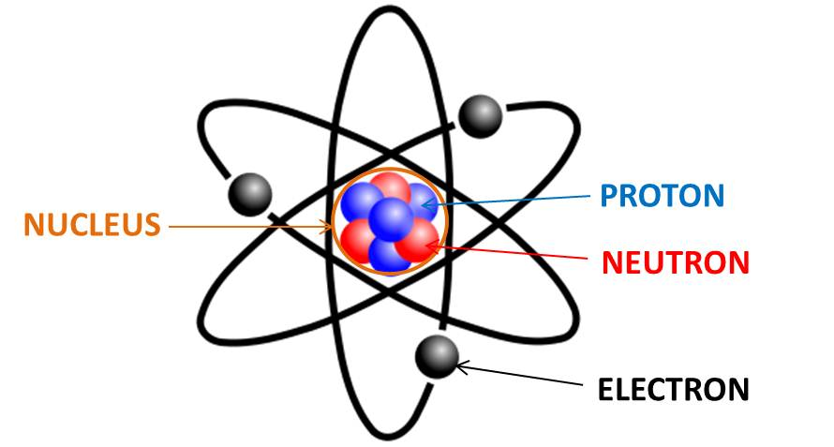
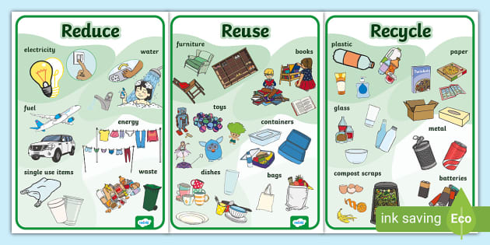
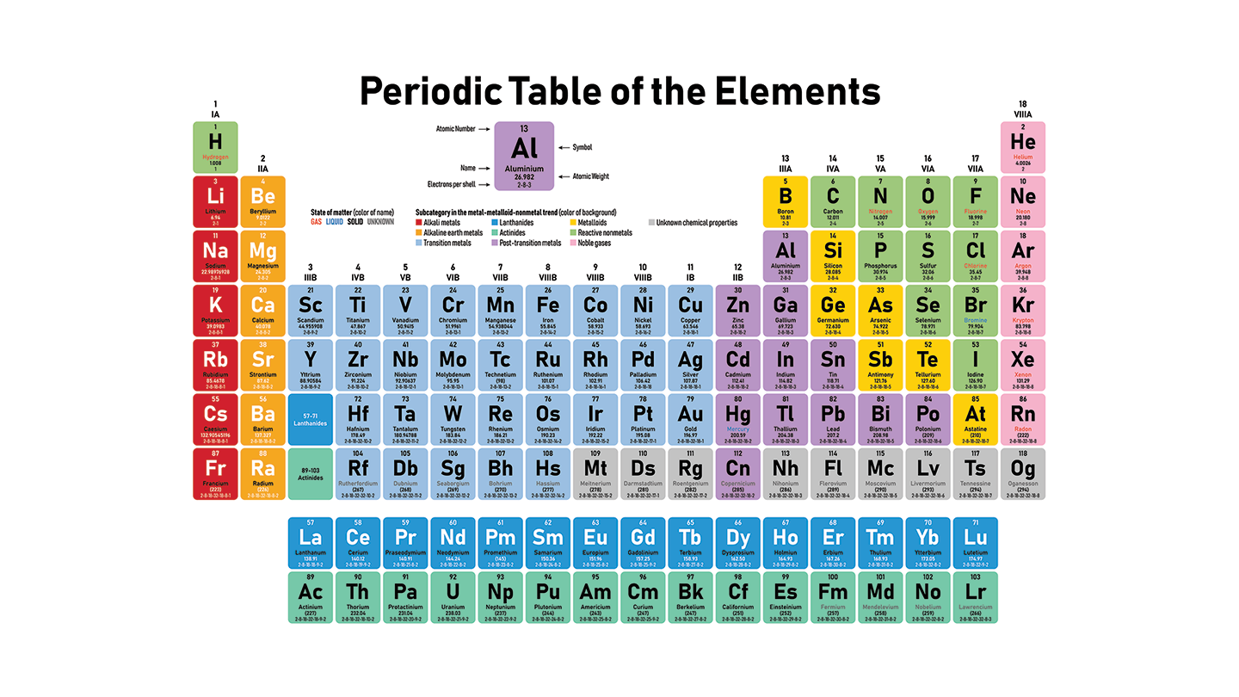
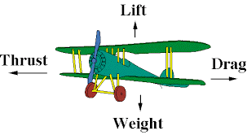
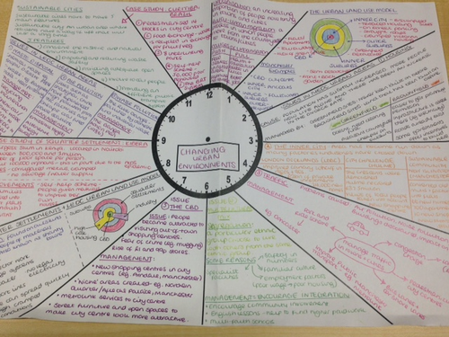
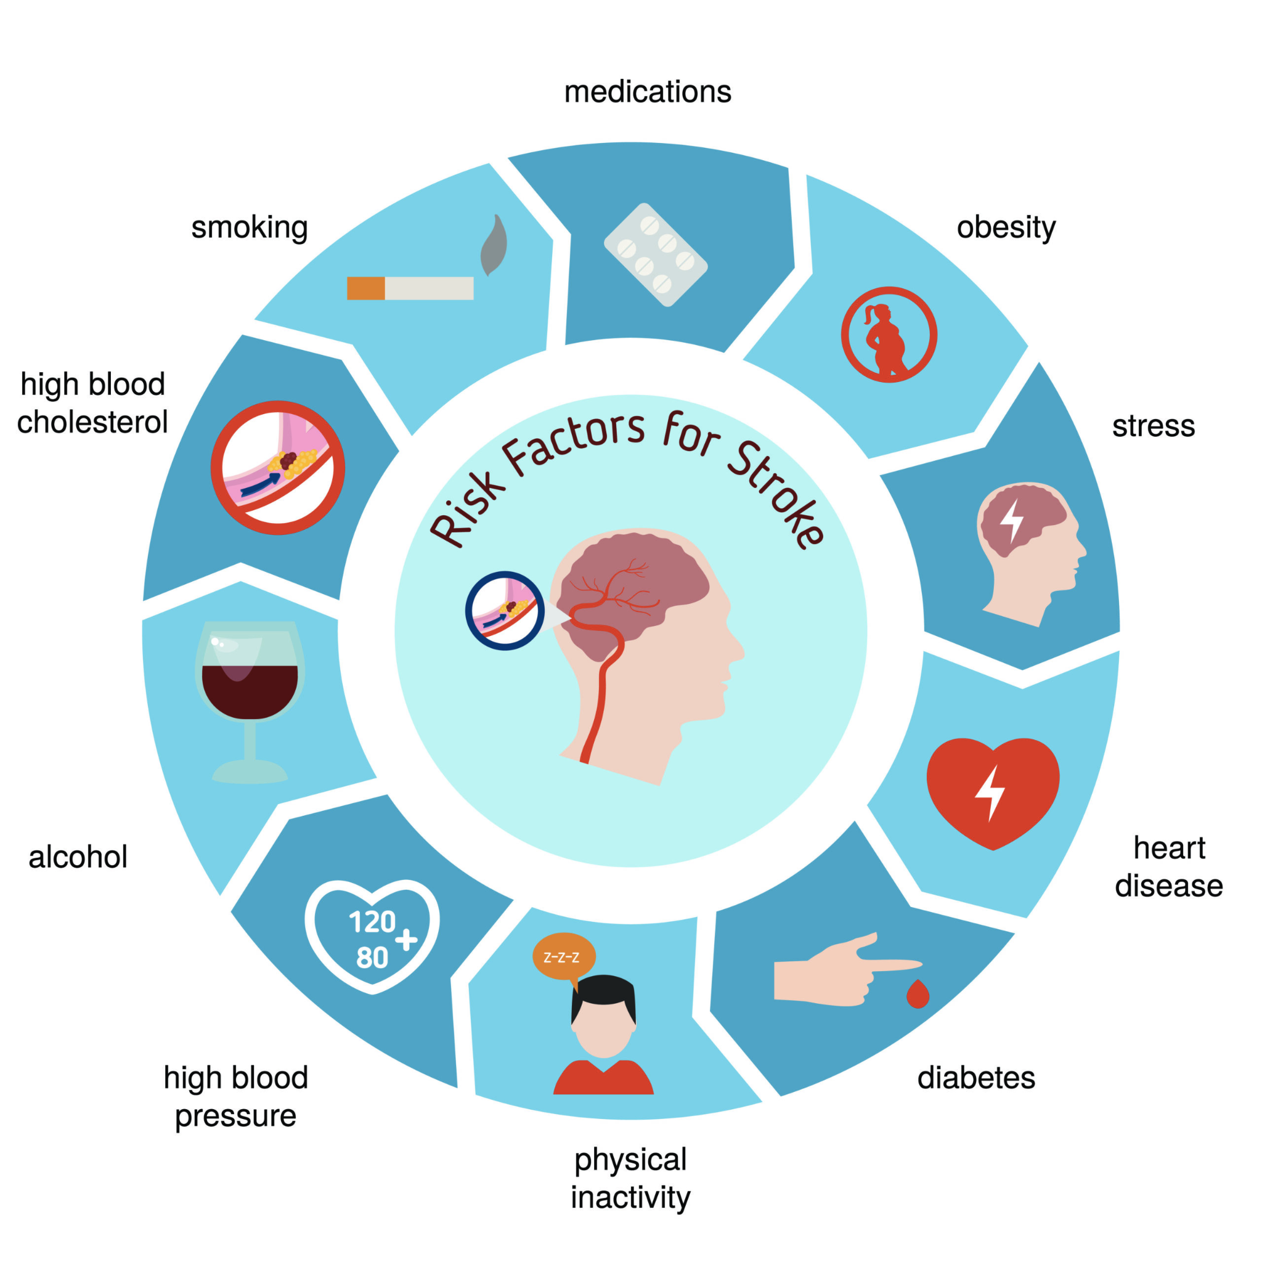
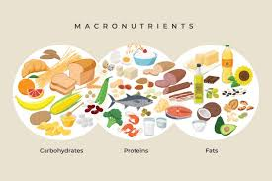
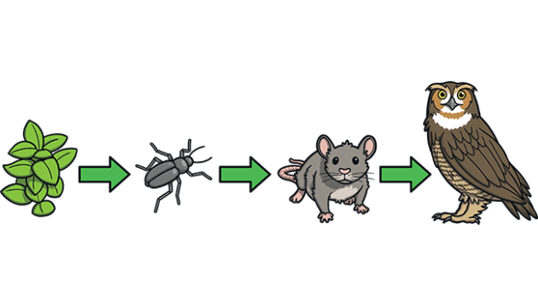
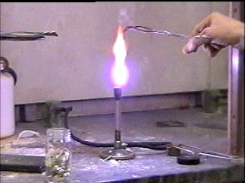
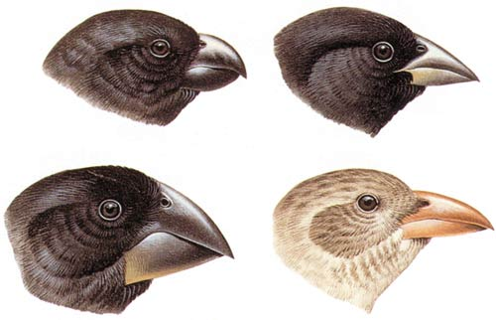
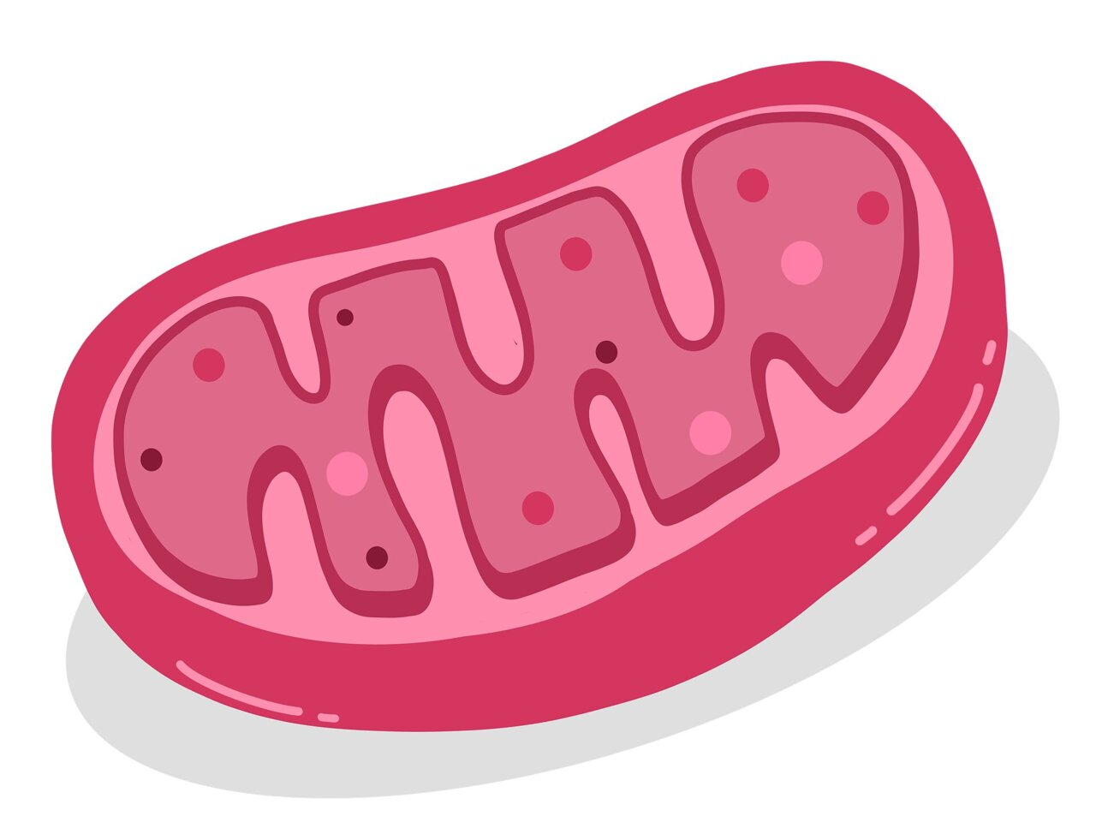
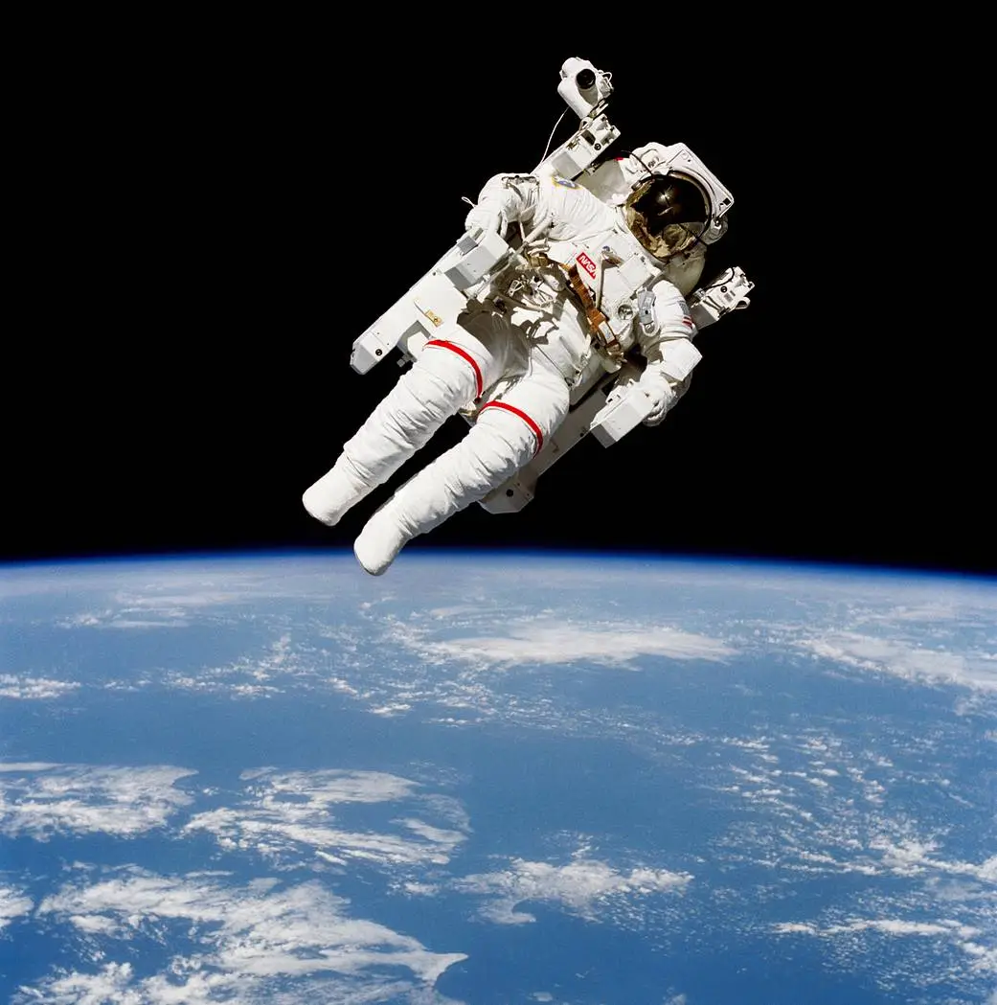
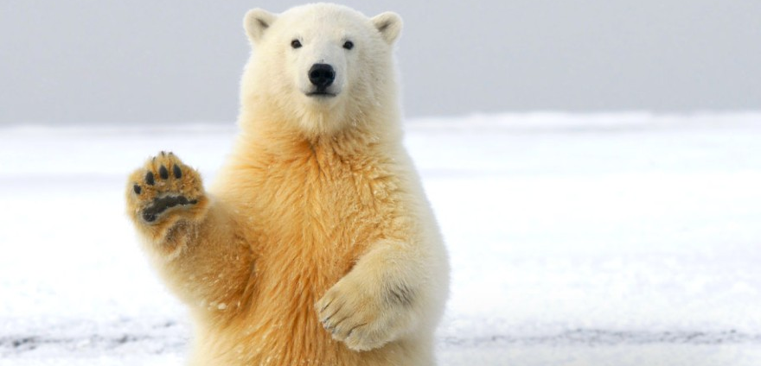
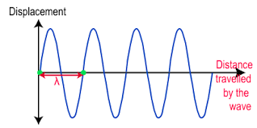
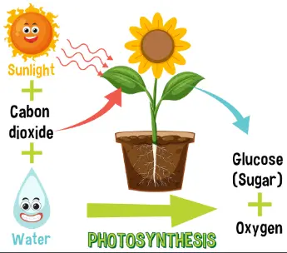
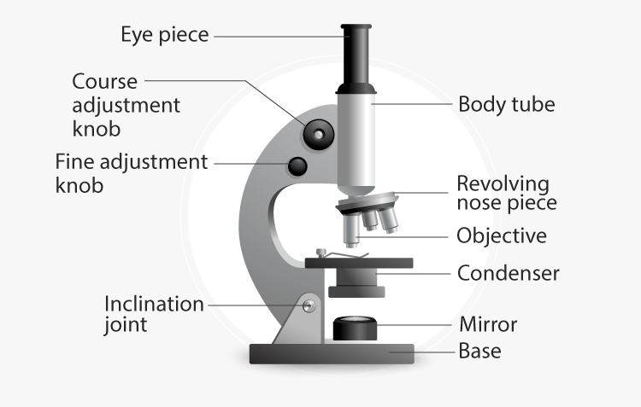
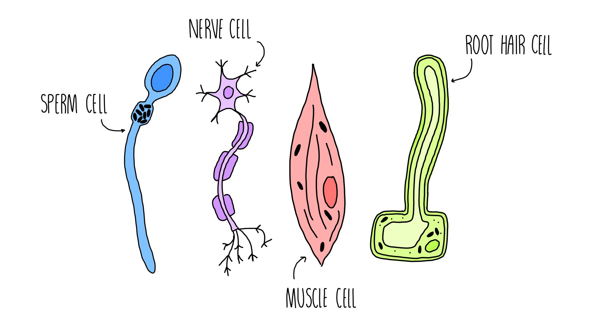
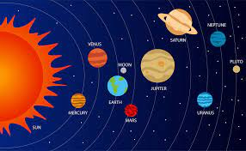
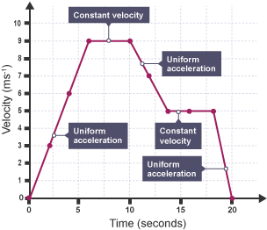
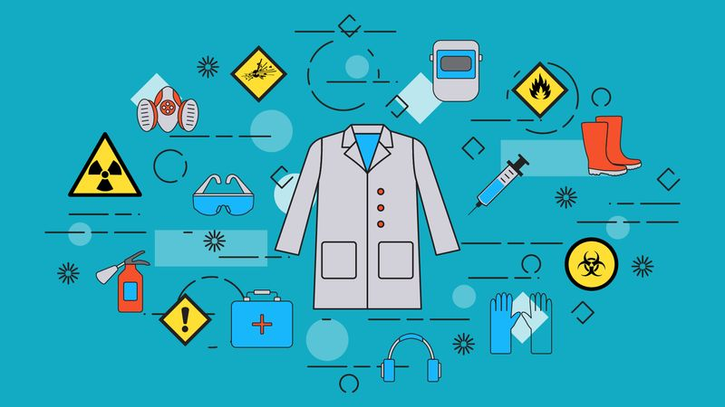
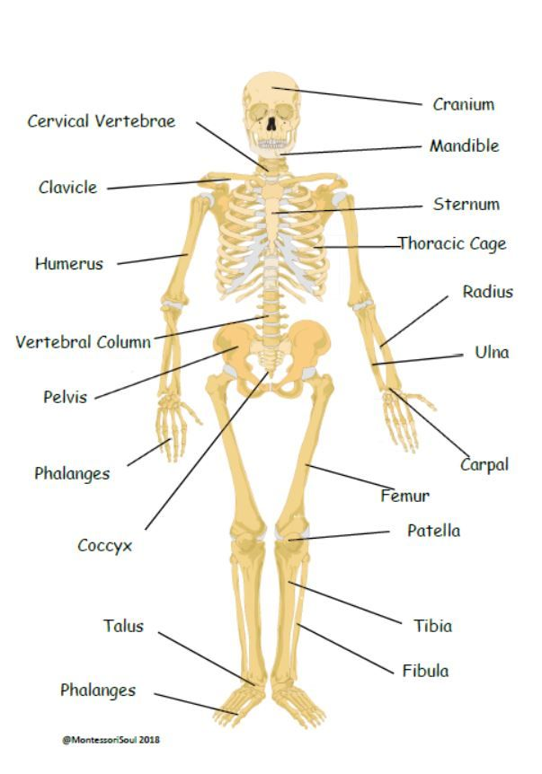
Continue your education by staring 6th form to study Chemistry A level
Continue your education by staring 6th form to study Biology A level
Continue your lifelong love of learning & personal development
Attend Yr11 Leavers’ event
Separate dyes based on the Rf value
Describe Newton’s three laws of motion
Explain how impulses and hormones are communicated in the body
Evaluate metal extraction techniques
Complete your Y10 end-of-year test to show off your learning.
YEAR
Continue your education by staring 6th form to study Applie Science
11
Debate the different things humans can do to improve the biodiversity on Earth.
Consider summer internship & voluntary work to enhance learning
Revise for & sit public GCSE exams
Explain factors affecting braking distance
Investigate reaction times
Investigate how to make a salt
Continue your Learning Journey through the KS4 national curriculum
Describe biotic and abiotic factors that impact the biodiversity of an ecosystem
Describe different diseases and their causes
Describe the different types of chemical bonds
Explain the properties of magnetism
Explain the properties of a reversible reaction
Evaluate how we can improve energy usage in society
Calculate the concentration of different chemicals
Explain uses of E.M waves in the world todays
Complete your Y9 end-of-year test to show off your learning.
YEAR
10
Evaluate how to protect against different diseases
Evaluate the importance of a vaccination programme
Investigate the five factors that affect a rate of a reaction
Differentiate between series and parallel circuits
Describe the properties of transverse and longitudinal waves
Explain how electricity is generated and used in the home.
Analyse the properties of different chemical structures
Describe the conservation of energy
Investigate the conservation of mass
Investigate Ohm’s Law
Explain the dangers of the different types of radiation.
Explain how substances are transported in and out of cells
Investigate different energy stores
Explain how cells grow from one cell to a multicellular organism.
Identify outliers in a set of data to ensure data is accurate.
YEAR
Complete your Y8 end-of-year test to show off your learning.
How do we obtain metals from metal ores?
9
Discuss which data presentation is best for a set of data.
Perform a scientific investigation with your working scientifically skills from Year 7 and 8
Explain how to build an electromagnet.
Complete investigations into separation techniques
Evaluate how we use the Earth’s natural resources and maintain them for future generations.
Analyse the evidence for evolution
Identify the subatomic particle
Evaluate the properties of different elements in the periodic table
Identify different types of drag forces
Use time to work with your science teacher to practise different retrieval techniques.
Explain how organisms breathe.
Describe the factors that affect a healthy lifestyle.
Explain how we can reduce our negative impact on the planet.
Explain how to maintain a healthy balanced diet.
Identify different forces in society
Explain how pressure is increased in liquids and gases.
Practise more good retrieval activities with teachers to prepare for end of year assessments
Describe what global warming is.
British Science Week - why is science important?
Investigate what food groups different foods belong to
Investigate if a reaction is exothermic or endothermic.
Investigate how magnesium burns in the flame of a bunsen burner
Explain how variation affects an organism's appearance
Draw a simple food chain in a local habitat
Describe different energy types in society
British Science Week - why is science important?
YEAR
Describe how plants photosynthesise their food.
8
Explain how organisms obtain energy through respiration
Describe a combustion reaction
Analyse data and explain their significance.
Complete your Y7 end-of-year test to show off your learning.
Explain how animals adapt to their environment e.g. a polar bear versus a camel
Explain why astronauts float on the moon but not on Earth.
Explain how sound and light travel
Fly some drones with the RAF
Discuss how the universe was created.
What acids and alkalis do we have in our cupboard?
How do they react?
Organisation of living things.
What is coronary heart disease?
How do we prevent having it when we are older?
Calculate the speed of an object.
Safety and expectations in the Laboratory – students will learn about safety aspects of working in a Practical Laboratory
Cells, tissues and organ systems
Specialised cells and their functions in organisms
What are the cells needed to make a baby?
What do you know about Science? Student will portray what they know about Science
Choose your science extra-curricular activities
What is the solar system?
Discuss how the solar system form. Did the ‘Big Bang’ happen?
What acids and alkalis do we have in our cupboard?
How do they react?
Explain how do we make a salt
Describe what is in our blood and how it moves around our body
YEAR
Attend Westfield’s summer school
Meet our SLT & pastoral leaders in 1:1 Yr6 meetings
Visit Westfield Academy during Transition Day
Develop a thirst for reading
7
PRIMARY SCHOOL
Complete your taster day booklet to support with your transition to secondary school
Sit SATS in Yr6
Apply for a place at Westfield Academy
Improve your literacy & numeracy through the form time programme
Meet our science teacher through Yr6 visits
Develop a lifelong love of learning

